Slide 1
Final Software Project
Austin Saechao
CST 499 Capstone for Computer Software Technology
January 29, 2024

Slide 2
SRS Overview
The Software Requirements Specification (SRS) document is a crucial blueprint for the CST499 final project, outlining the development of a student course enrollment system. Its primary objective is to establish a user-friendly, self-service website, granting students autonomy over their course schedules. The SRS is structured into five sections: Introduction, Overall Description, External Interface Requirements, System Features, and Other Non-Functional Requirements. The Introduction emphasizes the document's role in guiding system development, while Document Conventions ensure clarity for stakeholders. The Product Scope focuses on empowering students, and the Overall Description emphasizes cross-platform functionality. Design and Implementation Constraints, User Documentation, and Assumptions and Dependencies provide insights into project limitations. External Interface Requirements highlight design consistency, and the System Features section details critical features. Other Nonfunctional Requirements cover performance, safety, security, and business rules. The document concludes with a Glossary, ensuring clarity for stakeholders. In summary, the SRS serves as a comprehensive guide, addressing purpose, scope, structure, target audience, constraints, features, and nonfunctional requirements for successful project development.

Slide 3
UML
This paper underscores the critical role of software testing in ensuring software quality, dependability, and performance throughout the Software Development Life Cycle (SDLC). It delves into four main testing levels: Acceptance, System, Integration, and Component testing, each focusing on specific aspects of the product.
Component testing, or unit testing, involves the isolated examination of individual software components to detect bugs early in the coding process. This ensures accuracy and functionality, contributing to better code quality and simplified maintenance. Integration testing assesses the seamless interaction of software modules, identifying discrepancies and strengthening the overall system's functionality and dependability. System testing evaluates the software in simulated deployment scenarios, ensuring compliance with various requirements and acting as a gatekeeper before user availability. Finally, Acceptance Testing, performed by stakeholders and end users, verifies alignment with business requirements and user expectations, aiming to prevent post-deployment disparities and enhance user satisfaction.
In conclusion, these testing stages, from component to acceptance testing, are crucial for maintaining software quality and reliability. A comprehensive testing strategy, considering user needs and technological complexities, ensures robust, user-friendly software compliant with established standards, ultimately enhancing trustworthiness and preparing the system for reliable and efficient use

Slide 4
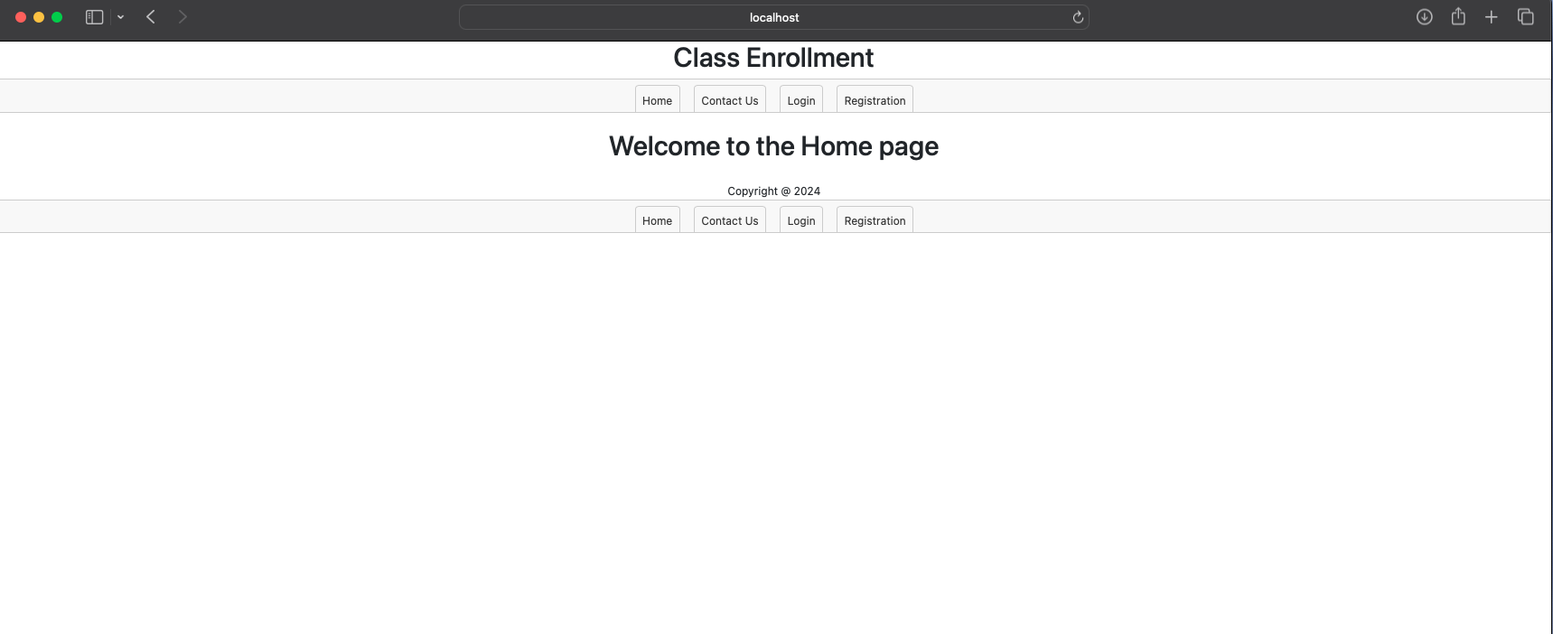
Landing Page
Notes:
This is an example of the home page when you go the to the main site. The site gives the option of the Home Page, Contact Us, Login, and Registration page.

Slide 5
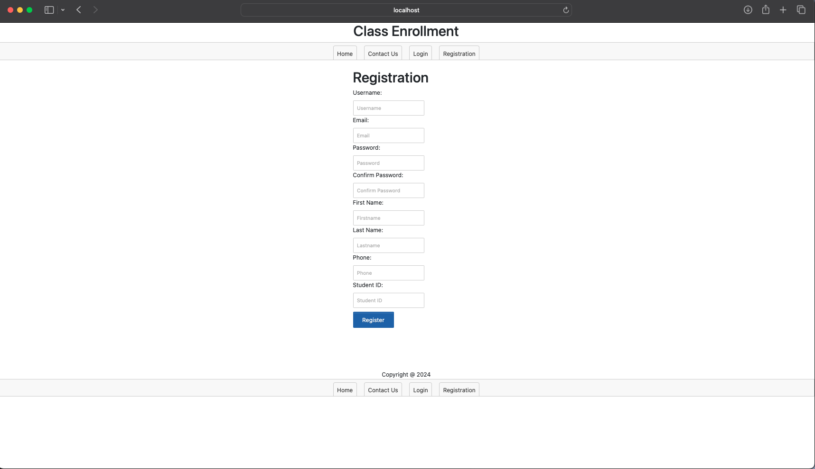
Registration Page
Notes:
This page give the option for a student to register for a login in. Once registered, the user will be able to login and have the ability to add and drop classes.

Slide 6
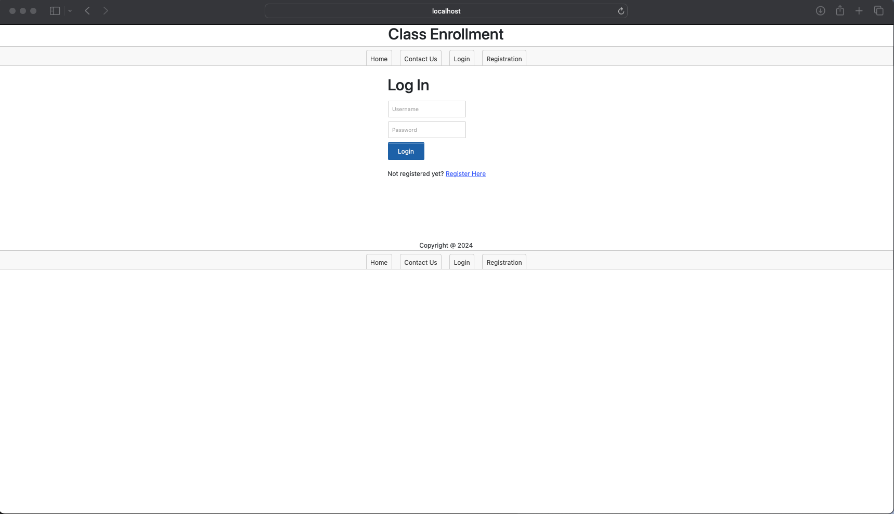
LOGIN Page
Notes:
This page give the ability to login using the user account that was created.

Slide 7
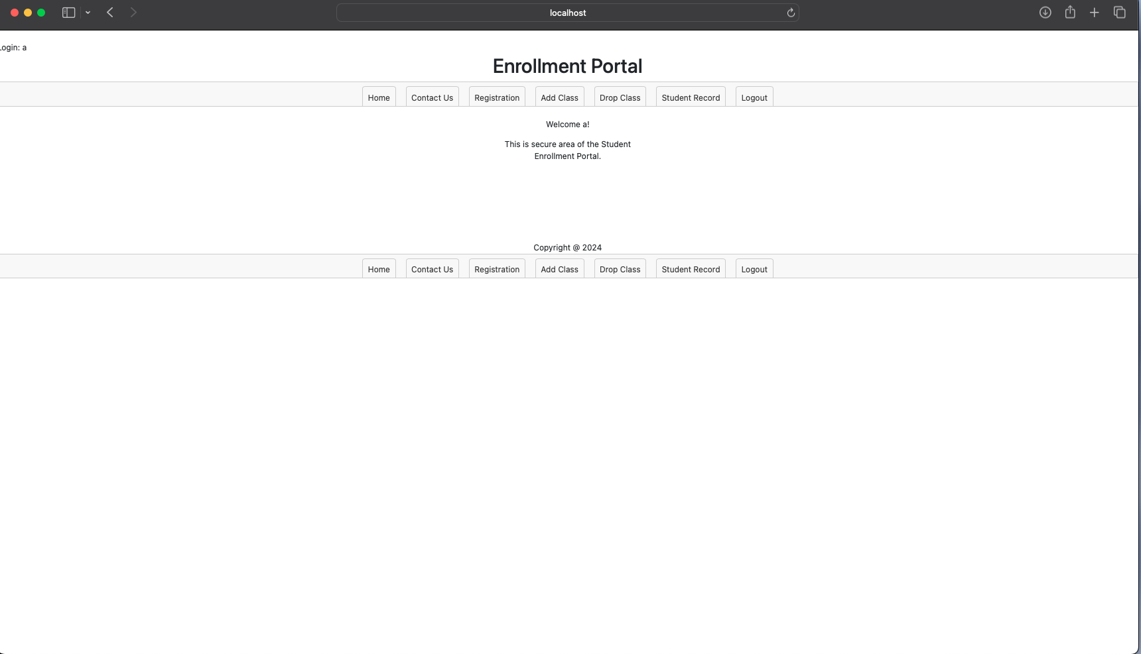
Secure home page
Notes:
This is the secure page where the user have an update menu bear, that allow for the user to add, drop, and view student record acitivty.

Slide 8
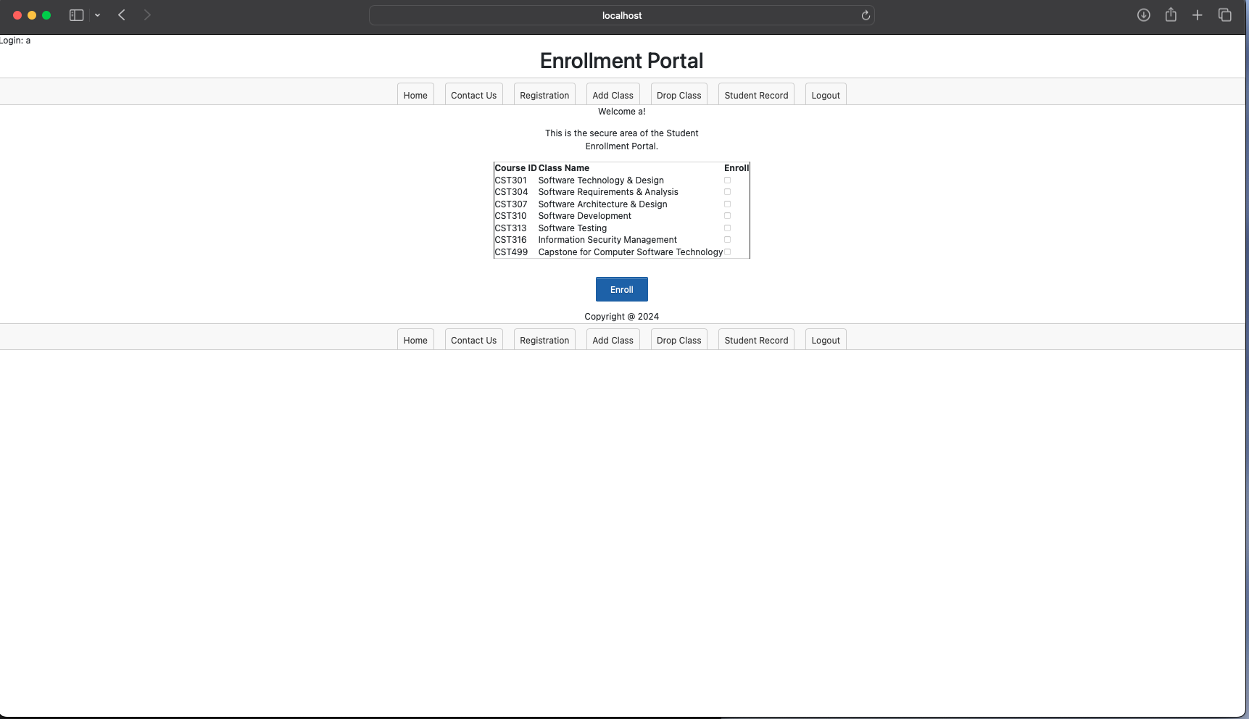
ADD Class
Notes:
This page list the available course that are being offer and that the user can enroll in. The student would have need to check the boxes for the class that they wish to enroll and click on the enroll button to submit the request.

Slide 9
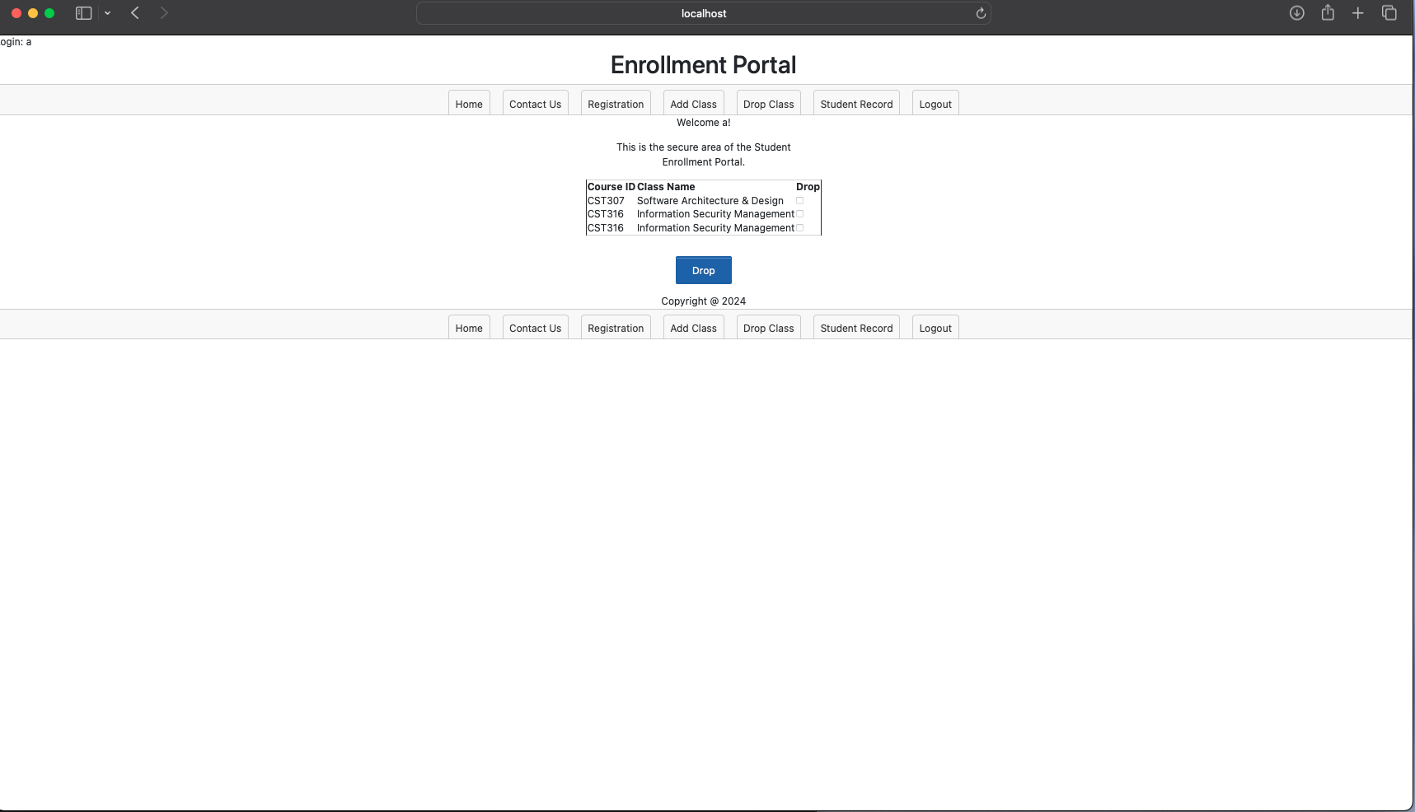
Drop CLass
Notes:
The page is shows all the course that the student is enroll in. If a student wait to drop from a class, then would need to click on the check box for the class and click on the DROP button.

Slide 10
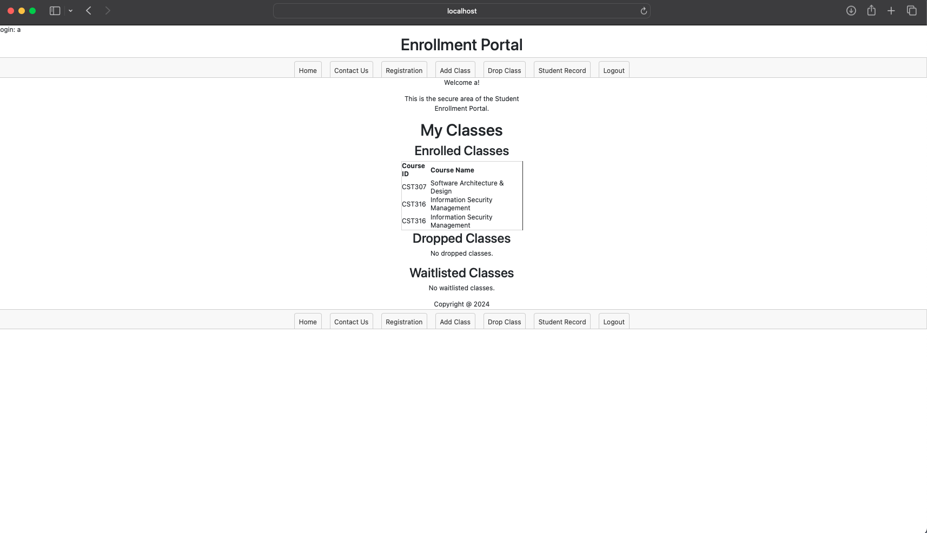
Student record
Notes:
This page shows all the classes that the user have enroll, drop, or on the wait list for.

Slide 11
SQL DAtabase
Overview of the SQL database base and the table that was create.
Notes:
tblUser – table that was create to store the registration information.
tblCourse – table that is user to store the class information
tblEnrollment -- use to store class that the students is enroll in
Tbldrop – use to store the drop courses information
Tblwaitlsit – use to store the waitlist class information

Slide 12
Live DEMO

Slide 13
Question

Slide 14
END of Presentation

